Slide 1
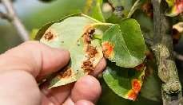
Plant Disease Detection using Image Processing and Machine Learning

Slide 2
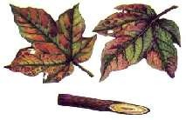
CONTENTS
Introduction
Problem statement
Objective
Existing system
Hardware and software requirement
Block Diagram of Proposed System
Our Methodology
Our Dataset
Most Common Diseases
K-Means Clustering,SVM,ANN
Future Scope
Conclusion

Slide 3
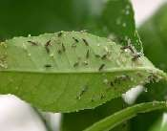
INTRODUCTION
India is an agricultural country; wherein most of the population depends on agricultural products.
Disease on any plants leads to the considerable reduction in both the quality and quantity of agricultural products.
Accurate detection and identification of crop diseases plays an important role in effectively controlling and preventing diseases for sustainable agriculture and food security.
For detecting crop disease early and accurately, a system is developed using image processing techniques and artificial neural network.

Slide 4
PROBLEM STATEMENT
To make an efficient use of Image Processing and Machine Learning Techniques by using our Software which reduces time and Cost for Farmer to detect the disease and Suggest the fertilizers for Plant.

Slide 5
OBJECTIVE
To increase the yield of the crop .
To help the farmers to have more income.
To detect diseases that occur on plants based on identification of the leaves.
Thus, to provide control and preventive measures to farmers so that diseases may not affect the yield and thus income.
Using Machine Learning(ML) techniques to increase the accuracy of the detection of diseases.

Slide 6

EXISTING SYSTEM
Existing System:
Colour based segmentation is available.
Little Image processing algorithms used.
Traditional approaches were used.
Lower Accuracy

Slide 7
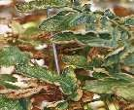
HARDWARE AND SOFTWARE REQUIREMENTS
Hardware Used :
Android mobile phone
PC
Software Used
1. MATLAB
2. Android Application

Slide 8
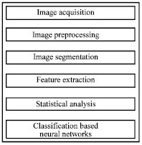
BLOCK DIAGRAM OF SYSTEM

Slide 9
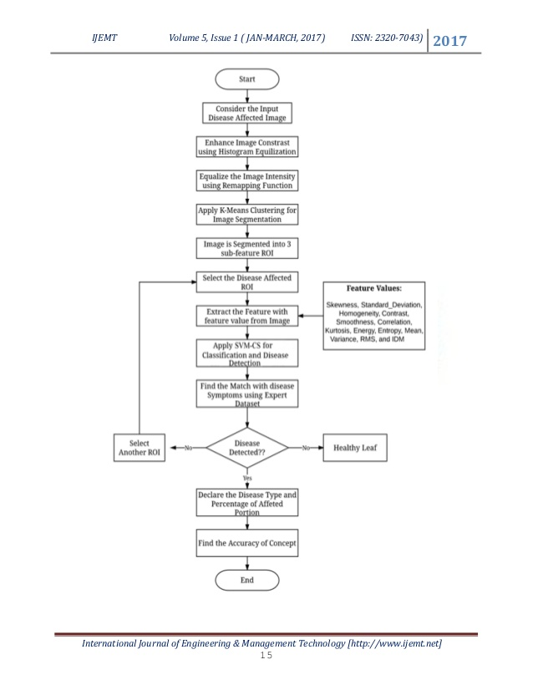
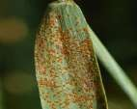
ACTIVITY DIAGRAM
0
Fig 3. ACTIVITY-diagram

Slide 10
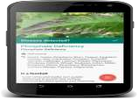

Our Methodology

Slide 11
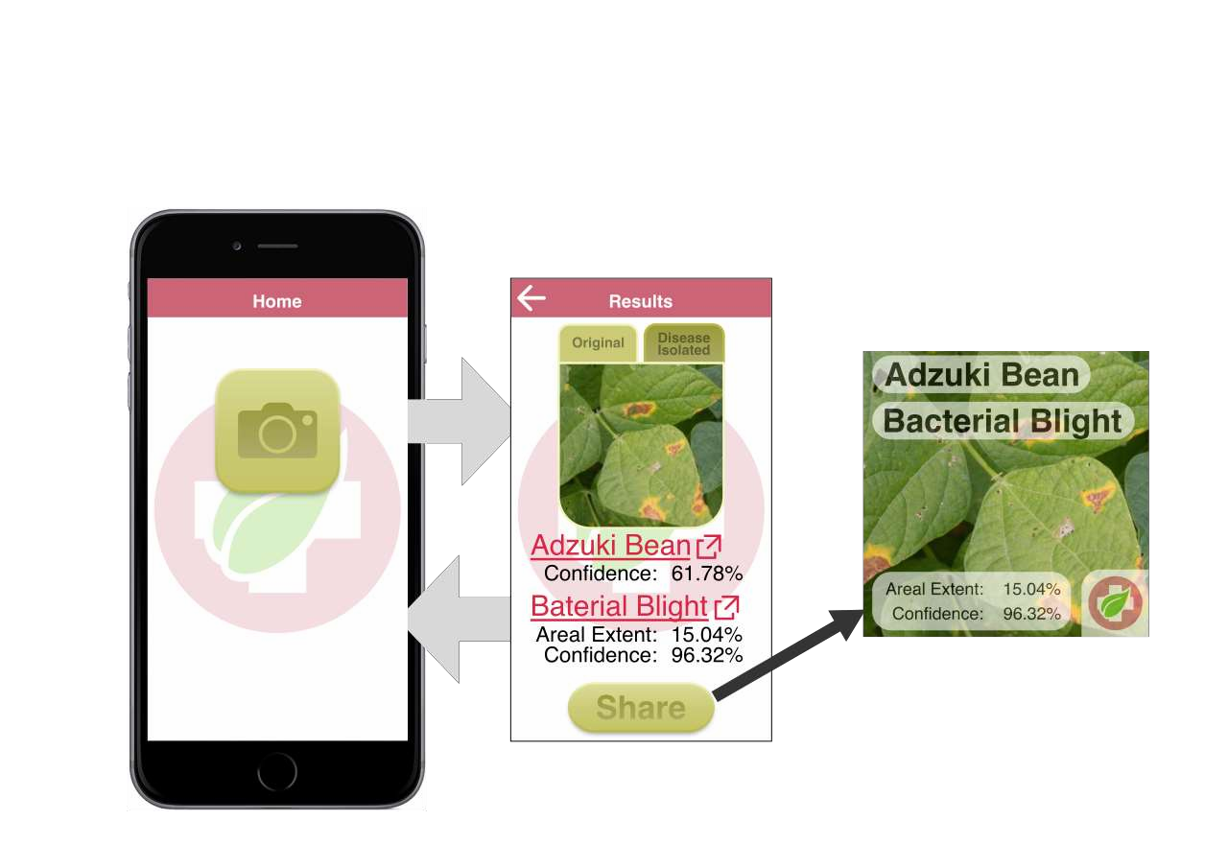
Our Methodology
Mobile App

Slide 12
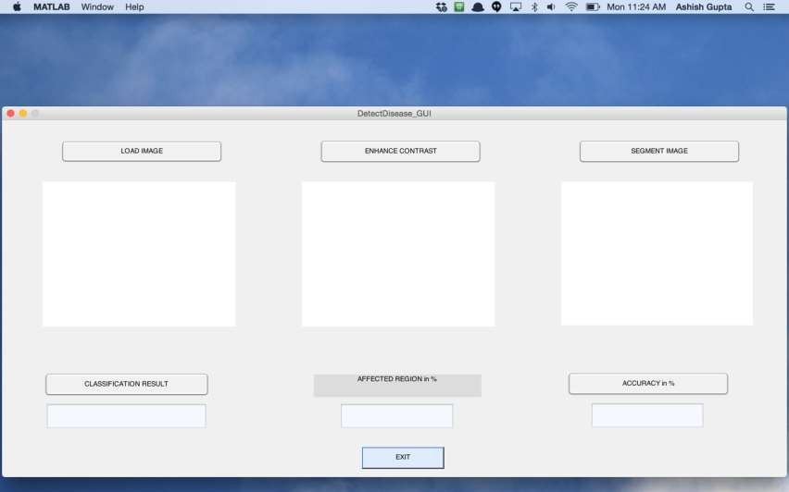
Our Methodology
MATLAB

Slide 13
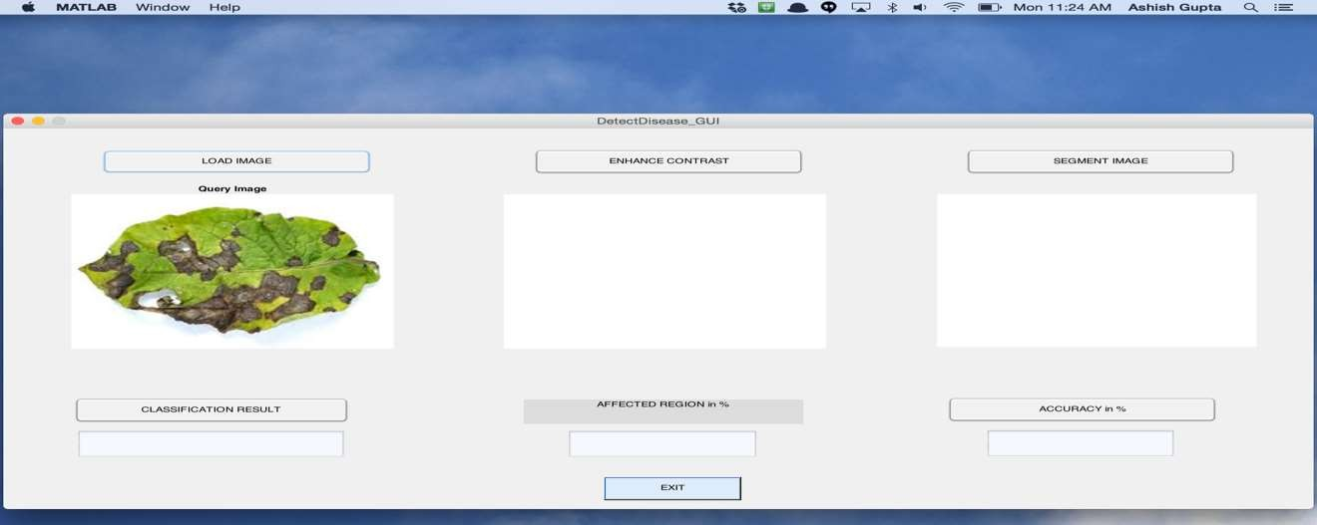
Our Methodology

Slide 14
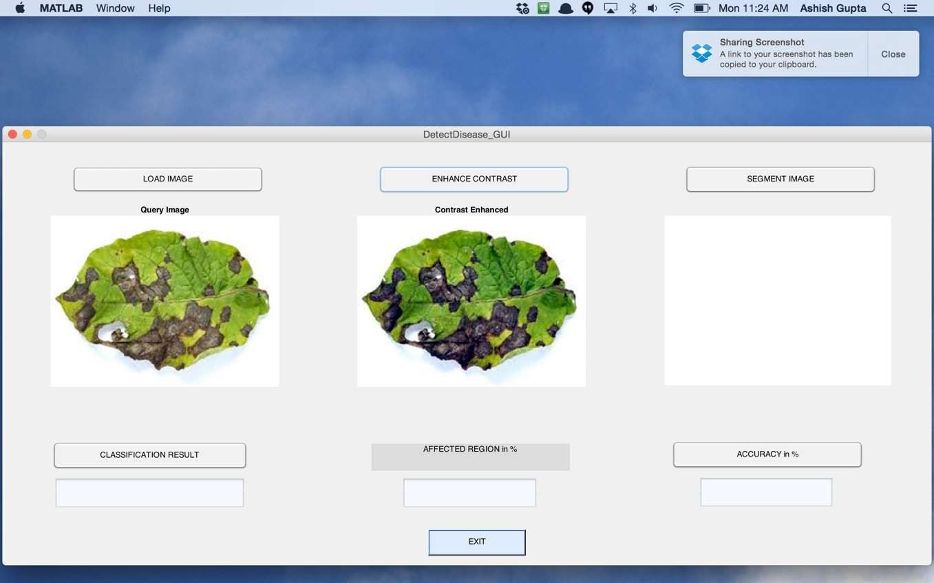
Our Methodology

Slide 15
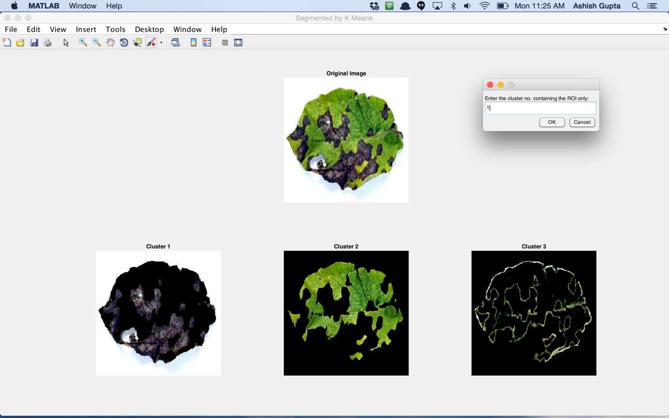
Our Methodology

Slide 16
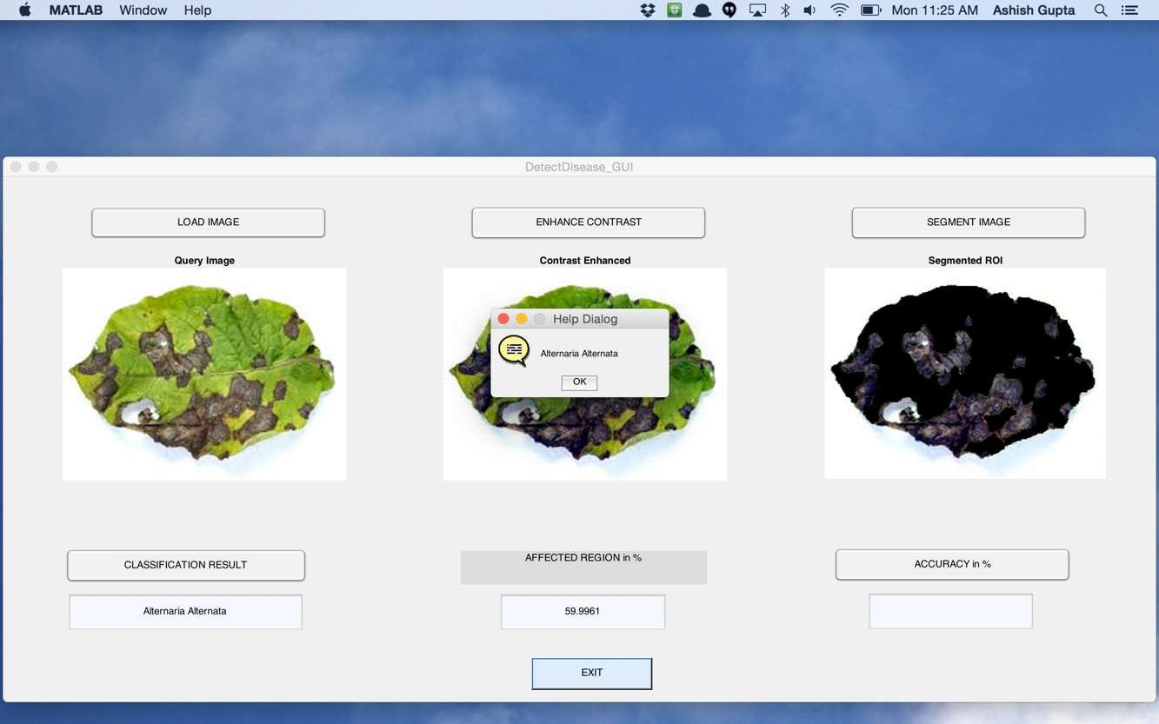
Our Methodology

Slide 17
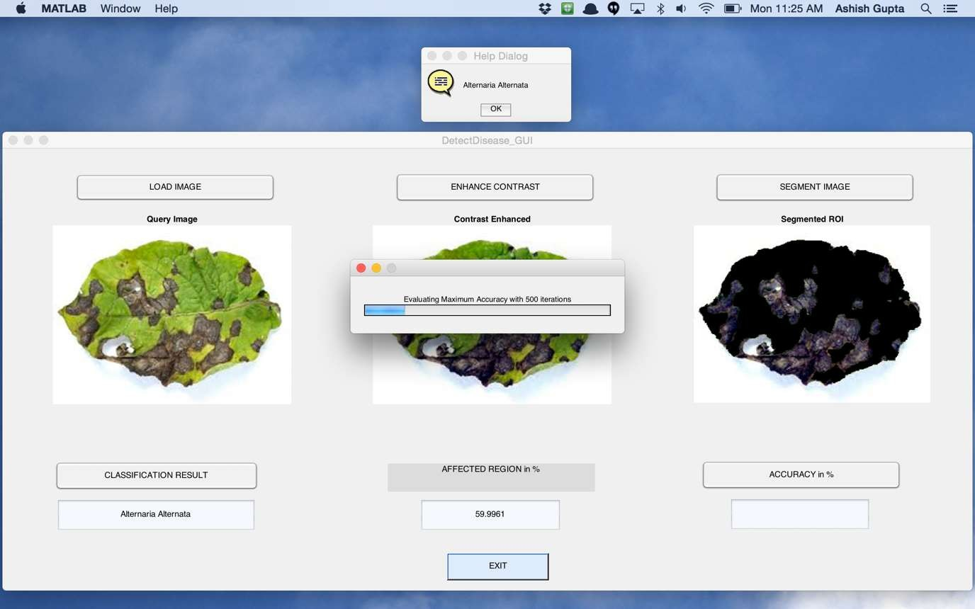
Our Methodology

Slide 18
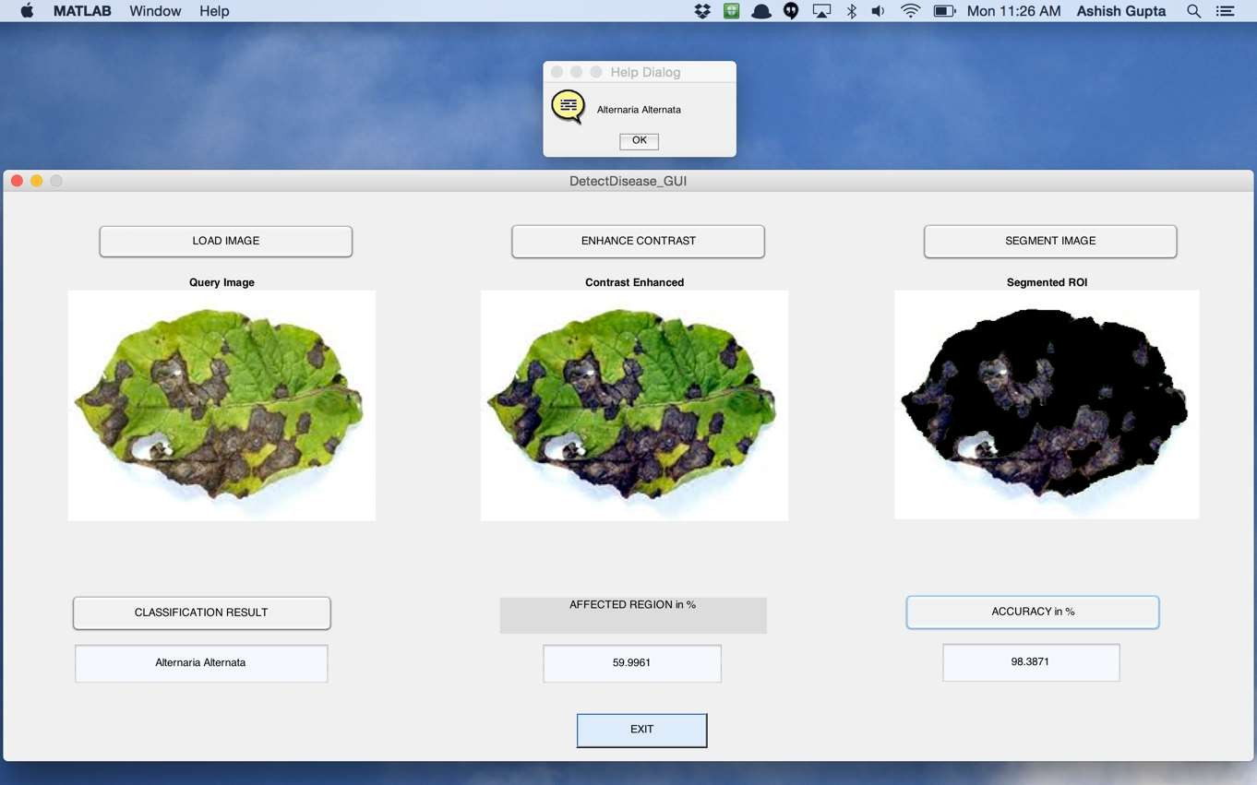
Our Methodology

Slide 19
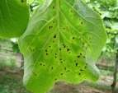
Our Dataset
Our Dataset consists of Four most common diseases occurred in plants ranging
from 0-4 as classes.
We have considered 125 sample of Leaves in Dataset
We have considered 13 Features of a Plant Leaf for our Analysis
Our dataset has calculated values of all this features

Slide 20
Most Common Diseases Found
Alternaria Alternata
Anthracnose
Bacterial Blight
Cercospora Leaf Spot

Slide 21
K-Means Clustering ALGORITHM
K-means is one of simplest unsupervised learning algorithms that solve the well known clustering problem
Classify a given data set through a certain number of clusters (assume k clusters) fixed Apriori.
The main idea is to define k centers, one for each cluster ,these centers should be placed in a cunning way
because of different location causes different result. So, the better choice is to place them as much as
possible far away from each other.
The next step is to take each point belonging to a given data set and associate it to the nearest center.
At this point we need to re-calculate k new centroids as barycenter of clusters resulting from the previous step.
After we have these k new centroids, a new binding has to be done between the same data set points and the nearest new center.

Slide 22
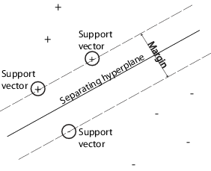
SVM Classification Algorithm
“Support Vector Machine” (SVM) is a supervised machine learning algorithm which can be used for both classification or regression challenges. However, it is mostly used in classification problems.
In this algorithm, we plot each data item as a point in n-dimensional space
(where n is number of features you have) with the value of
each feature being the value of a particular coordinate.
Then, we perform classification by finding the hyper-plane that
differentiate the two classes very well (look at the below snapshot).

Slide 23

Artificial Neural Network
Algorithm for classification using ANN:
Preparing the data
Creating training sets
Creating testing sets
Pre-process the data into a form that can be used with a neural network. The neural network object in the
MATLAB toolbox expects the samples along columns and its features along rows. Our dataset has its samples
along rows and its features along columns. Hence the matrices have to be transposed.
Now the network is ready to be trained. Here testing set is created while creating the training set. The
training set is used to teach the network. Training continues as long as the network continues improving
on the validation set. The test set provides a completely independent measure of network accuracy.

Slide 24
Artificial Neural Network
Testing the classifier :
The trained neural network can now be tested with the testing samples. This will give us a sense of how well
the network will do when applied to data from the real world.
Computation of classification accuracy using confusion matrix
The network response can now be compared against the desired target response to build the classification
matrix which will provide a comprehensive picture of a classifiers performance.

Slide 25
Future Scope
Anyone, literate or illiterate will be able to use easily this application.
It will help Agriculture Officer to check quality of crop without any manual supervision.
Data obtained from farmers will help Government to Identify the disease produced in particular region and thus take proper action to prevent or control it.

Slide 26
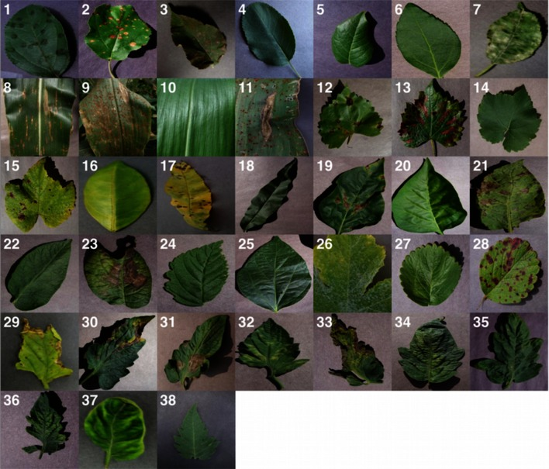
Different Pattern in Plant leafs

Slide 27
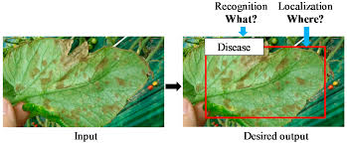

Slide 28
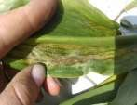
CONCLUSION
This proposed system describes different techniques of image processing for detecting plant diseases.
The disease of the plant is known at at an early stage and the cure is suggested using different languages namely Hindi or English.

